Slide 1
Making this resource work for you
Prior to teaching this lesson, please refer to the ‘Unit Overview and Planning Document’.
Further guidance on planning Science Mastery lessons can be found in the detailed planning guidance document.
Refer to the ‘notes’ section on each slide for useful information, including suggested expositions, pedagogical content knowledge, suggested questions, answers and more. Consider using presenter mode so you can see this guidance throughout the lesson.
The introduction slides can be adapted to suit your teaching style and the needs of your class.
Before the lesson, adapt the fix-it slide to address any misconceptions identified in the previous lesson’s exit ticket.
Choose from the suggested activities to suit your class. The intention is not that you complete all of these, but that you select those which ones are most appropriate for your students. It may be appropriate to further adapt activities for your students.
These lessons are designed to occupy approximately 1 hour. To adapt for a shorter or longer lesson duration we advise you to adapt the activity section accordingly.
Please consider using the final slide to send feedback about this lesson or examples of PowerPoints that you have adapted to our design team. Your feedback is used to improve Science Mastery for all of our teachers and students. We appreciate all suggestions and comments.
Thank you for reading!
The Science Mastery Team

Slide 2
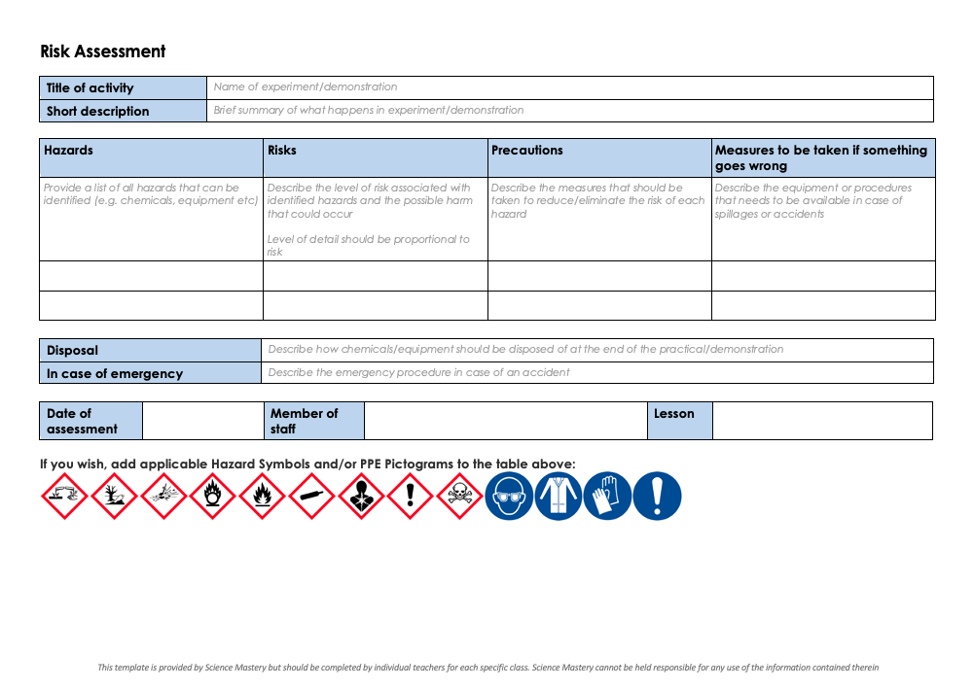
Practical Activity
This lesson contains a practical activity (either a whole class activity or a demonstration)
A risk assessment must be completed for this practical
The template risk assessment can be found here.
The risk assessment should be specific to the class involved and written only by the teaching member of staff
The risk assessment should refer to the current CLEAPSS Hazcards for all chemicals used in the practical for safety and disposal notes.
A list of chemicals used can be found in the Practical Guide
It is good practice for students to wear safety spectacles during all class practicals and demonstrations
Thank you for reading!
The Science Mastery Team

Slide 3
Diffusion in Living Things
Answer the questions below.
Define diffusion.
State the factors that would increase the rate of diffusion.
What is a concentration gradient?
Explain how the structure of root hair cells helps them carry out their function.
Explain why diffusion could not occur in a solid.
The net movement of particles of a liquid or gas from an area of high concentration to an area of low concentration.
Increasing temperature, increasing surface area and increasing concentration gradient.
The difference in concentration of a substance between two areas.
They have a long shape giving them a large surface area, which helps them to absorb water.
The particles in a solid can only vibrate from their positions, they cannot move freely.
Notes:
Foundation: Name the cellular process that releases energy.
Stretch: Explain why diffusion is a critical process for human survival.
Answers:
Foundation: (aerobic) respiration
Stretch: Oxygen needs to get into the bloodstream so it can get to cells for respiration and carbon dioxide needs to diffuse out. Nutrients also diffuse into the bloodstream through the small intestine, which provides glucose, also for respiration. There are a number of other relevant answers here.

Slide 4
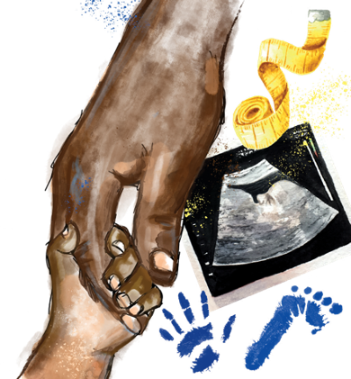
B3.1.8
17/10/2024
Diffusion in Living Things
B3.1.1 Prior Knowledge Review
B3.1.2 Eukaryotic and Prokaryotic Cells
B3.1.3 Aseptic Technique
B3.1.4 Growth of Bacteria
B3.1.5 Microscopes
B3.1.6 Observing Cells
B3.1.7 Diffusion
B3.1.8 Diffusion in Living Things
B3.1.9 Osmosis
B3.1.10 Osmosis Investigation
B3.1.11 Active Transport
B3.1.12 Cell Division
B3.1.13 Cancer
B3.1.14 Stem Cells
Notes:
Big Idea: Cells are alive
In the previous lesson pupils looked at the process of diffusion. Here they will deepen their understanding of why diffusion is important, not just for humans but for other living things.
Suggested Hook:
Many organisms that need to respire aerobically (so need oxygen) do not have lungs eg fish, insects, single celled organisms, plants. Ask pupils’ how do these organisms get the oxygen they need for respiration?’ There is a chance to come back to this question in the talk task about an insect.

Slide 5

Following this lesson, students will be able to:
State the effect of surface area to volume ratio on exchange
Describe how multicellular organisms are adapted to allow the efficient exchange of substances
Explain why unicellular organisms do not need these adaptations in order to survive
Key Words:
adaptation
diffusion
efficient blood supply
alveoli
surface area to volume ratio

Slide 6
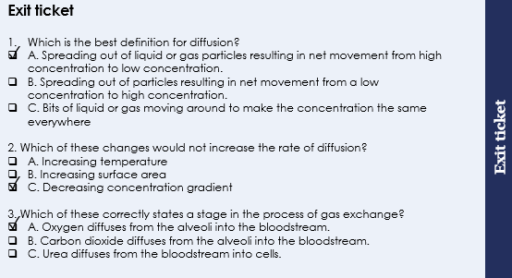
This is the fix-it portion of the lesson
The fix-it is an opportunity to respond to gaps in knowledge, especially those identified by the previous lesson’s exit ticket.
The teacher should customise this slide as needed, to facilitate
reteach, explanation, demonstration or modelling of ideas and concepts that students have not yet grasped or have misunderstood.
practise answering specific questions or of key skills.
redrafting or improving previous work.
Notes:
Purpose: to spend time on any gaps identified in previous learning from exit ticket feedback.
Answers:
Q1. Answer: A
If pupils answered B they have incorrectly understood particles ‘spreading out’ or not read the whole sentence (C is technically the right idea but is not written scientifically so is not the best definition). To fix it get pupils to explain the process of diffusion, using a diagram to aid their explanation.
Q2. Answer: C
If pupils answered A or B they have a misconception around the factors affecting diffusion. To fix it, it could be useful to demo how each factor affects the rate of diffusion, e.g. with potassium permanganate at different temperatures or adding into an existing solution (smaller concentration gradient)
Q3. Answer: A
If pupils answered B or C they have incorrectly identified the direction of diffusion. To fix it revise aspects of the circulatory system and gas exchange – why cells need oxygen, and to get rid of carbon dioxide and urea.

Slide 7

Diffusion in Living Things
Unicellular organisms have a relatively high surface area to volume ratio, which allows efficient diffusion of required substances
Large multicellular organisms generally have a lower surface area to volume ratio but many have adaptations that increase their surface area to allow more efficient diffusion
Notes:
Purpose: introducing new knowledge
Suggested script:
Last lesson we learnt how to calculate SA:vol. Smaller objects will have a higher SA:vol than larger objects. Very small unicellular organisms such as bacteria therefore have a very high SA:vol. This means it is easy for substances (such as oxygen, water, glucose etc) to diffuse through the cell membrane and subsequently to the rest of the cell.
Multicellular organisms such as animals and plants are much larger than unicellular organisms so have a much lower SA:vol. It is not feasible that multicellular organisms would be able to absorb required substances through diffusion in the same way as unicellular organisms. These multicellular organisms have adaptations to increase their surface area in the places where diffusion happens. These adaptations are present in all multicellular organisms but look different depending on the type of organism.
Common examples shown, both have maximum surface area. Always relate structure back to its function in explanations.
Pointing at the root hair cell diagram. What is the function of a root hair cell? To absorb water and minerals from the soil. Root hair cells have a large surface area compared to other types of leaf cell in order to absorb maximum amount of water.
Pointing at the section of a leaf diagram. Leaves (particularly spongy mesophyll cells) are organised to maximise surface area - not packed so closely/rigidly as the palisade mesophyll.
Pointing at the red blood cell image. Red blood cells have a biconcave disc shape which leads to a greater surface area draw a biconcave shape vs flat cell shape on the board to emphasise the difference.
Suggested guidance: For more able pupils you may want to engage in a discussion about further adaptations, e.g. RBCs have no nucleus to maximise the amount of haemoglobin they can hold, therefore carry more oxygen.
This links back to the effect of size on the uptake of diffusion activity from the previous lesson. This activity can be carried out as part of this lesson alternatively.
Red blood cell image: https://commons.wikimedia.org/wiki/File:Red_blood_cells.svg

Slide 8
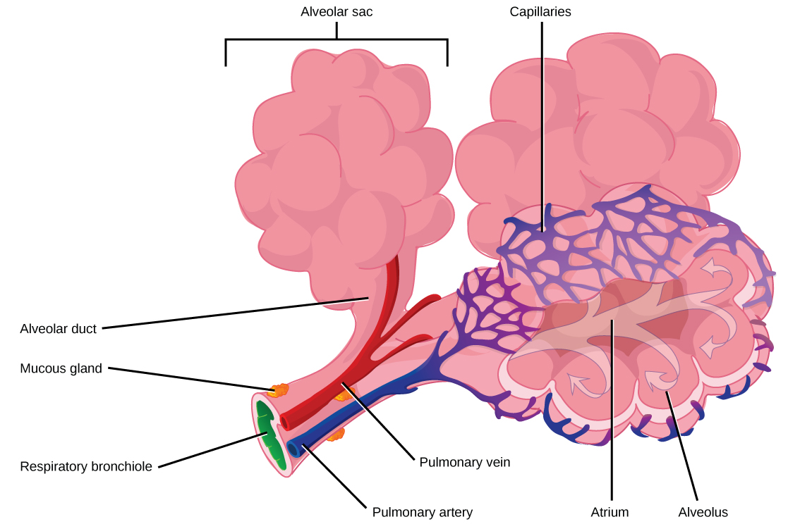
Diffusion in Living Things
Cell membranes are often very thin, creating a very short path for diffusion
Alveoli in the lungs maximise the surface area
Gills are also structured to have a large surface area
Alveoli and gills both have an efficient blood supply, which helps to maintain a large concentration gradient as substances are carried away quickly
Notes:
Purpose: introducing new knowledge
Suggested script:
To be efficient at diffusion structures where diffusion occur will have:
A short diffusion path (thin membrane or only one layer of cells)
A large surface area, like in alveoli and in gills point to the images
A way of maintaining the concentration gradient ie once diffusion has happened those particles should not stay where they are. This is often done via a good blood supply so that substances are carried away in the blood stream as soon as diffusion has happened.
Both alveoli and gills have the same job what job is that? Gas exchange. Even though they are different structures found in different organisms both alveoli and gills have structures that give them the same features- large SA, thin for short diffusion path, good blood supply to maintain the concentration gradient.
What other structures did we encounter in the digestive system that also have these features (in y8)? Villi
Gills are arranged in layers in tissues that are like short threads, protein structures called filaments. Similar texture to the layers in the underside of a mushroom, may help pupils to visualise.
Suggested guidance: Emphasise these three factors as the principles are the same for any structures that present for efficient diffusion. Pupils should be able to identify these three factors in organisms/structures they have not seen before.
Alveoli image: https://commons.wikimedia.org/wiki/File:Figure_39_01_09.jpg
Gills image: https://commons.wikimedia.org/wiki/File:Tuna_Gills_cut_out.jpg

Slide 9
Structure of the alveolus
It is important that oxygen diffuses rapidly from the air in the alveoli into the bloodstream.
Alveoli are efficient for diffusion because:
The walls are thin, made of just one layer of epithelial cells
They have a large surface area: There are lots of them and they are spherical in shape
They have a good blood supply: There are lots of blood capillaries wrapped around them.
They are moist, which helps gases to diffuse across more easily.
Notes:
This is an optional review from B2.1.
Model teacher exposition: This information should be dual-coded for the students on the whiteboard.
This same video describes the features of the alveoli after 2 minutes (continue from previous part of the lesson)
https://www.youtube.com/watch?v=Nwz4EaO5H2Y
Alveoli are made of specialised tissue that allow for efficient gas exchange.
1. The walls are thin (made of just one single layer of cells). This means that there is a short distance for diffusion.
2. Alveoli have a large surface area. If you laid out all the membranes in your lungs it would take up half a tennis court! This means that there is a faster rate of diffusion.
3. Alveoli have a very good blood supply. This means that oxygenated blood is taken away from the lungs quickly. This ensures there is always a gradient so that oxygen diffuses into the blood and carbon dioxide diffuses out.
4. Alveoli are moist. This means that the gases can dissolve, making it easier for them to pass across the alveolar wall.
Possible questions:
Do unicellular organisms need alveoli? No because oxygen can diffuse directly into the cell
What would happen to the rate of diffusion if the walls were thick? Why? It would decrease because the diffusion distance would be larger
What organ of the body ensures blood is continuously moving? The heart

Slide 10
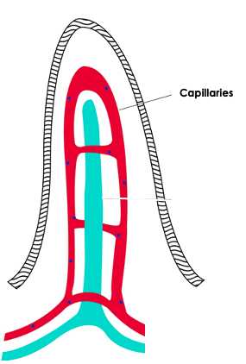
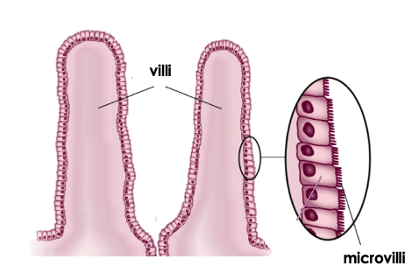
The Lining of the Small Intestine
When molecules are absorbed, they diffuse from the small intestine into the bloodstream.
The small intestine is adapted for diffusion:
It is folded into lots of tiny structures called villi
Each villi is lined by specialised cells which have parts called microvilli
Each villi has a good blood supply
Notes:
This is an optional review from B2.4.
Suggested teacher exposition:
The small intestine has several different adaptations that make it well suited for absorption. It is a long muscular tube folded into lots of tiny structures called villi (singular villus). Villi increase the surface area over which absorption can happen. These villi are then lined with the specialised cells we just learnt about. Because the small intestine is so folded, if it was unravelled and stretched out it would actually be nearly 5 metres long!
What effect does surface area have on the rate of diffusion?
The greater the surface area, the higher the rate of diffusion.
Villi also have an excellent blood supply because they contain lots of capillaries. This means that as nutrients are absorbed they can be carried away quickly, which has the effect of maintaining a concentration gradient.
What is a concentration gradient?
The difference in concentration between two areas.
Having a large concentration gradient increases the rate of diffusion.
The microvilli are only one cell thick.
How might this affect diffusion?
This increases the rate of diffusion as there is a short pathway for molecules.
Images:
https://commons.wikimedia.org/wiki/File:Villi_%26_microvilli_of_small_intestine.svg
https://commons.wikimedia.org/wiki/File:Intestinal_villus_simplified_esp.jpg

Slide 11
Quick Quiz
Choose the correct answer for each question:
Why are unicellular organisms usually able to allow efficient diffusion?
A. They have always have a large surface area
B. They have a small surface area to volume ratio
C. They have a large surface area to volume ratio
2. What do alveoli and gills have in common?
A. They both have a large surface area and efficient blood supply
B. They both allow organisms to breathe
C. They both allow carbon dioxide to diffuse in and oxygen to diffuse out
3. Which is an example of an adaptation to increase efficiency of diffusion?
A. Red blood cells having a large volume so they can carry a lot of oxygen
B. Root hair cells have a large surface area so a lot of water can be absorbed
C. Spongy mesophyll cells having lots of chloroplasts to absorb sunlight
✓
✓
✓
Notes:
Purpose: assess understanding of new information and key prior knowledge. Get students to hold up fingers for their chosen answer. Take consensus with answers and use questioning to explain why these are the answers and why other answers are incorrect.

Slide 12
Drill
Name the type of organism with a large surface area:volume ratio
State the function of alveoli and gills.
State and explain how the following structures have adapted to maximise efficient diffusion in larger multicellular organisms:
Cell membranes
Blood supply
Structures with projections/finger like shape
State where oxygen diffuses to, from the alveoli, during inhalation.
Describe the shape of a villi in the small intestine
Explain why this shape helps diffusion to take place
Notes:
Purpose: This is a knowledge drill. The purpose of this is to check that the critical knowledge is secure before pupils move onto independent practice.
Suggested guidance: There are a range of ways this could be done depending on time and ability range of the class:
Mini whiteboards
As full sentences in exercise books
As short answers in exercise books
In the pupil workbook
As pair talk
As cold call

Slide 13
Drill answers
Unicellular organism
Gas exchange
a) Thin membrane for short diffusion pathway
b) Good blood supply to maintain concentration gradient
c) These structures have a large surface area for maximum diffusion
4. Capillaries/the blood
5. Finger-like projection
6. Increases surface area
Notes:
Purpose: This is a knowledge drill. The purpose of this is to check that the critical knowledge is secure before pupils move onto independent practice.
Suggested guidance: There are a range of ways this could be done depending on time and ability range of the class:
Mini whiteboards
As full sentences in exercise books
As short answers in exercise books
In the pupil workbook
As pair talk
As cold call

Slide 14

I: Explain using scientific understanding to make something clear
Example question:
To ‘explain’ your answer should:
Begin with a scientific statement.
Use ‘this means that’, ‘because’ or ‘so’ to link your statement to the question.
Explain how the human respiratory system is adapted to maximise the rate of gas exchange (give three adaptations).
Model answer:
Large number of alveoli to increase surface area
Alveoli/capillaries have thin walls to reduce diffusion distance
Good blood supply to maintain concentration gradient
All of these adaptations increase the rate of diffusion, which means there is a greater rate of gas exchange
Notes:
This slide models the process of answering an explain question.
Firstly, students are presented with a generic explain question, along with a model answer. Students are also given some simple guidance to follow for producing their own describe answer.
The generic question and answer should be used by the teacher to remind students of
the key features of a great answer
how to structure their answer
why the model answer is a good example
Following this, students will be required to apply this process to answer their own explain question, which will appear in place of the generic questions. This explain question will be specific to the topic students are learning about in the lesson. Give students time to write their own answer to this, ensuring that they use the guidance provided. To further scaffold this task for students, it may be appropriate to:
pair students up to write an answer together
list for students the key words you would like them to include in the answer
provide a writing frame or ‘points to include’ for students
A model answer for this question will appear. Teachers should review the model answer with students by referencing the guidance in the green box. For example ‘we can see item 1 in the guidance is to begin with a scientific statement. Notice in the model answer here we have done just that’. Or ‘item 2 in the guidance here says that we should use a linking statement in the answer. Has this been achieved in the model answer? Where can we see this?’.

Slide 15
We: Explain using scientific understanding to make something clear
Example question:
To ‘explain’ your answer should:
Begin with a scientific statement.
Use ‘this means that’, ‘because’ or ‘so’ to link your statement to the question.
Explain how gills in fish are adapted to maximise the rate of gas exchange.
Model answer:
Gill filament shape provides a large surface area
Gill cell membranes have thin walls to reduce diffusion distance
Good blood supply to maintain concentration gradient
All of these adaptations increase the rate of diffusion, which means there is a greater rate of gas exchange
Notes:
This slide models the process of answering an explain question.
Firstly, students are presented with a generic explain question, along with a model answer. Students are also given some simple guidance to follow for producing their own describe answer.
The generic question and answer should be used by the teacher to remind students of
the key features of a great answer
how to structure their answer
why the model answer is a good example
Following this, students will be required to apply this process to answer their own explain question, which will appear in place of the generic questions. This explain question will be specific to the topic students are learning about in the lesson. Give students time to write their own answer to this, ensuring that they use the guidance provided. To further scaffold this task for students, it may be appropriate to:
pair students up to write an answer together
list for students the key words you would like them to include in the answer
provide a writing frame or ‘points to include’ for students
A model answer for this question will appear. Teachers should review the model answer with students by referencing the guidance in the green box. For example ‘we can see item 1 in the guidance is to begin with a scientific statement. Notice in the model answer here we have done just that’. Or ‘item 2 in the guidance here says that we should use a linking statement in the answer. Has this been achieved in the model answer? Where can we see this?’.

Slide 16
You: Explain using scientific understanding to make something clear
Example question:
To ‘explain’ your answer should:
Begin with a scientific statement.
Use ‘this means that’, ‘because’ or ‘so’ to link your statement to the question.
Explain how the small intestine is adapted for efficient absorption of nutrients into the blood by diffusion.
Model answer:
Villi folds provide a large surface area
Walls of villi are thin to reduce diffusion distance
Good blood supply to maintain concentration gradient
All of these adaptations increase the rate of diffusion
Notes:
This slide models the process of answering an explain question.
Firstly, students are presented with a generic explain question, along with a model answer. Students are also given some simple guidance to follow for producing their own describe answer.
The generic question and answer should be used by the teacher to remind students of
the key features of a great answer
how to structure their answer
why the model answer is a good example
Following this, students will be required to apply this process to answer their own explain question, which will appear in place of the generic questions. This explain question will be specific to the topic students are learning about in the lesson. Give students time to write their own answer to this, ensuring that they use the guidance provided. To further scaffold this task for students, it may be appropriate to:
pair students up to write an answer together
list for students the key words you would like them to include in the answer
provide a writing frame or ‘points to include’ for students
A model answer for this question will appear. Teachers should review the model answer with students by referencing the guidance in the green box. For example ‘we can see item 1 in the guidance is to begin with a scientific statement. Notice in the model answer here we have done just that’. Or ‘item 2 in the guidance here says that we should use a linking statement in the answer. Has this been achieved in the model answer? Where can we see this?’.

Slide 17
Diffusion in Living Things
Complete the worksheet on diffusion in living things
Use full sentences and keywords where necessary
Notes:
Self/peer assess using mark scheme
Application of diffusion from given examples and previous lesson.
Common Misconception - glucose in the small intestine is taught later in the unit as an example of active transport. It also occurs by diffusion when the concentration of glucose is higher in the intestine than the bloodstream, but has to take place by active transport when the concentrations become equal. This is an important point to note and useful to discuss at this point so pupils do not become confused and think every time they see villi used as an example it must be diffusion. It is good practice for them to look at the concentrations present and then they can determine whether diffusion will be able to occur.
Stretch activity – linking to previous knowledge from B1.2 and development of embryos.

Slide 18
Describe: to recall facts, events or processes in an accurate way
Describe how one feature of the axolotl’s gills increases the rate of diffusion of oxygen.
To ‘describe’, your answer should:
Use bullet points to keep your answer clear
Cover enough points to fully answer the question
Use scientific keywords in your answer
‘Say what you see’ if there is a diagram, graph or table.
Model answer:
The gills have many projections
To increase surface area for diffusion
The projections are very thin
To ensure a short diffusion path
Notes:
This slide models the process of answering a describe question.
Firstly, students are presented with a generic describe question, along with a model answer. Students are also given some simple guidance to follow for producing their own describe answer.
The generic question and answer should be used by the teacher to remind students of
the key features of a great answer
how to structure their answer
why the model answer is a good example
Following this, students will be required to apply this process to answer their own describe question, which will appear in place of the generic questions. This describe question will be specific to the topic students are learning about in the lesson. Give students time to write their own answer to this, ensuring that they use the guidance provided. To further scaffold this task for students, it may be appropriate to:
pair students up to write an answer together
list for students the key words you would like them to include in the answer
provide a writing frame or ‘points to include’ for students
A model answer for this question will appear. Teachers should review the model answer with students by referencing the guidance in the green box. For example ‘we can see item 1 in the guidance is to use bullet points to keep your answer clear. Notice in the model answer here we have done just that’. Or ‘item 2 in the guidance here says that we should use scientific keywords in the answer. Has this been achieved in the model answer? Where can we see this?’.

Slide 19
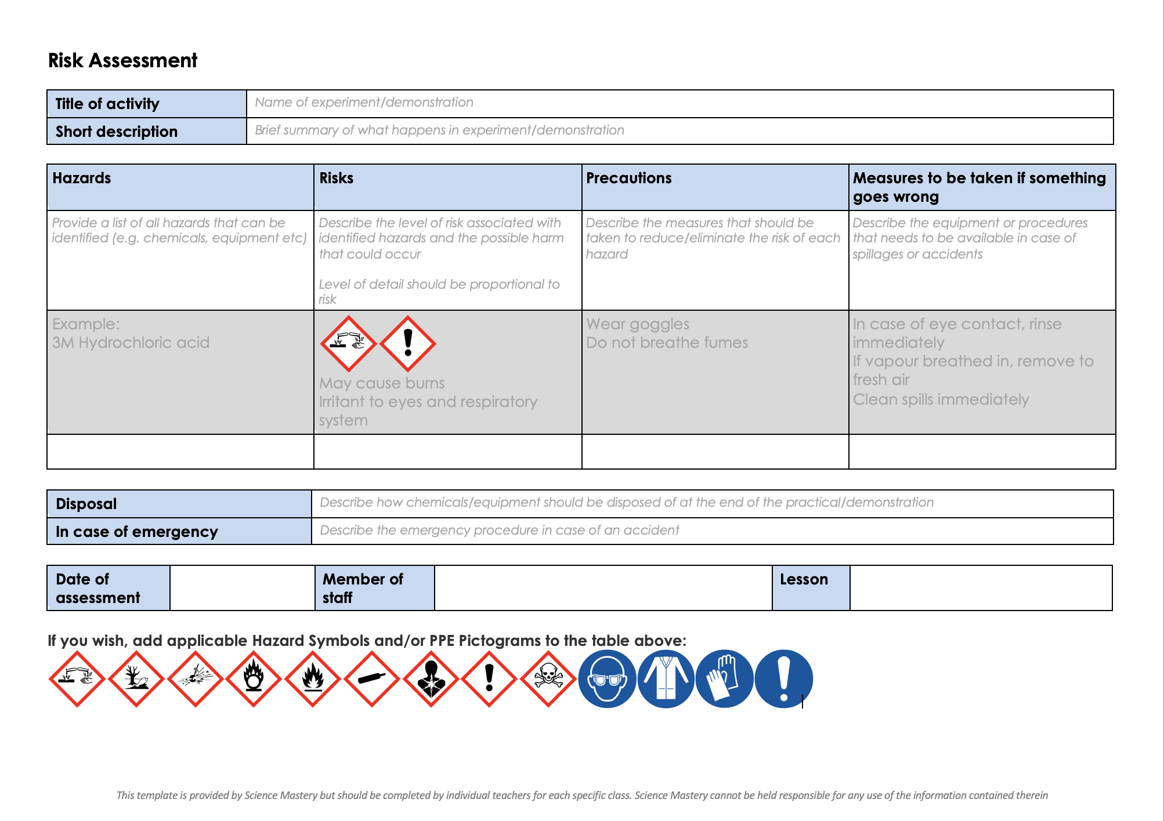
Risk Assessment
A risk assessment must be completed for this practical
The template risk assessment can be found here.

Slide 20
Diffusion Demonstration
Explain what happens in this demonstration.
Use the words diffuse, concentration, gradient, particle in your answer.
Notes:
This resource by RSC (https://edu.rsc.org/resources/diffusion-of-gases-ammonia-and-hydrogen-chloride/682.article) shows you how to carry out the classic demonstration on diffusion where two invisible gases travel down a tube from opposite ends and react where they meet to form a white solid. When you open the file, scroll down the list then click on “diffusion”. It’s recommended that you talk through the reaction with students before starting this demo. You can mix the two solutions together and show that they react to produce a new white solid. In this situation it is helpful to refer to the hydrochloric acid as a solution of hydrogen chloride. Students should be able to write a word equation for the reaction and more able students will be aided in their understanding by seeing the symbol equation. This way, pupils will have a better understanding of what is happening when they see the white “smoke” form. When carrying out the demonstration, minimise the time delay between inserting the cotton wool in either end by preparing both beforehand and leaving them on the petri dish until needed.
Challenge the class to explain why the solid doesn’t form in the middle of the tube. There’s no need to discuss molecular mass at this level, but most should appreciate that the ammonia must have travelled more quickly than the hydrogen chloride.
For one demonstration:
Eye protection (goggles)
Access to a fume cupboard
Protective gloves, preferably nitrile
A length of glass tube about half a metre long with an inside diameter of about 2 cm (Note 1)
Retort stands with bosses and clamps, 2
Small wads of cotton wool, 2
Bungs, to fit into the ends of the glass tube, 2
Strip of universal indicator paper (optional)
Concentrated hydrochloric acid (CORROSIVE), a few cm³ (Note 2)
880 ammonia solution (CORROSIVE, DANGEROUS FOR THE ENVIRONMENT), a few cm³ (Note 2)
Acetone (FLAMMABLE), a few cm³ (optional) (Note 1)
Refer to Health & Safety and Technical notes section below for additional information.
Teaching notes
The reaction which is taking place is: ammonia + hydrogen chloride → ammonium chloride
NH₃ (g) + HCl (g) → NH₄Cl (s)
The exact time taken for the ring to form will depend on the dimensions of the tube, the amount of the solutions which are put on the cotton wool wads and the temperature of the room.
The ring usually forms nearer to the hydrochloric acid end of the tube because hydrogen chloride diffuses more slowly than ammonia. This is because hydrogen chloride has almost twice the molecular weight of ammonia, and the rate of diffusion is inversely proportional to the square root of the molecular mass of the gas.
It is worth noting that the rate of diffusion is not the same as the speed at which the gas molecules travel (which is hundreds of meters per second). The gas molecules follow a zig-zag path through the tube as they collide with the air molecules in the tube.
The purpose of the glass tube is to eliminate air currents and to see if the gas molecules will move on their own.

Slide 21
Answer the questions below.
Which describes an example of diffusion?
A. Oxygen molecules moving from an area of low concentration in the bloodstream to an area of high concentration in the cells
B. Glucose molecules moving from an area of high concentration in the small intestine to an area of lower concentration in the bloodstream
C. Gills taking in water molecules to allow respiration in fish
2. Which would be useful adaptations to increase the rate of diffusion?
A. A long path for diffusion and thick blood vessels
B. A short path for diffusion and thick blood vessels
C. A short path for diffusion and an efficient blood supply
3. Unicellular organisms generally allow efficient diffusion because…
A. They are very small so don’t need many molecules to have a high concentration
B. They have a relatively large surface area compared to their volume
C. They have a relatively large volume compared to their surface area
✓
✓
✓
Notes:
Purpose: to find out if students are able to answer key questions that check for understanding of the new information that have been covered.
Answers:
Q1. Answer: B
If pupils answered incorrectly they have not got the correct definition of diffusion, A has the wrong concentration gradient and C links to water. To fix this ask pupils to write a scientific definition of diffusion and explain why it is useful.
Q2. Answer: C
If pupils answered incorrectly they do not know the adaptations to increase the rate of diffusion, both A and B indicate a misconception around the length of diffusion path. To fix this show diagrams of short and long diffusion paths and ask pupils to identify which one would reach equal concentrations sooner.
Q3. Answer: B
If pupils answered A they may have misunderstood that unicellular organisms need many substances just as multicellular organisms do. If they answered B there is a misconception around linking SA:Vol to diffusion. To fix this explain Sa:vol in more detail and use diagrams to show how it can speed up diffusion.

Slide 22
Lesson B3.1.8
What was good about this lesson? | What can we do to improve this lesson?
Send us your feedback by clicking this link
or by emailing sciencemastery@arkonline.org
Thank you!

